Slide 1
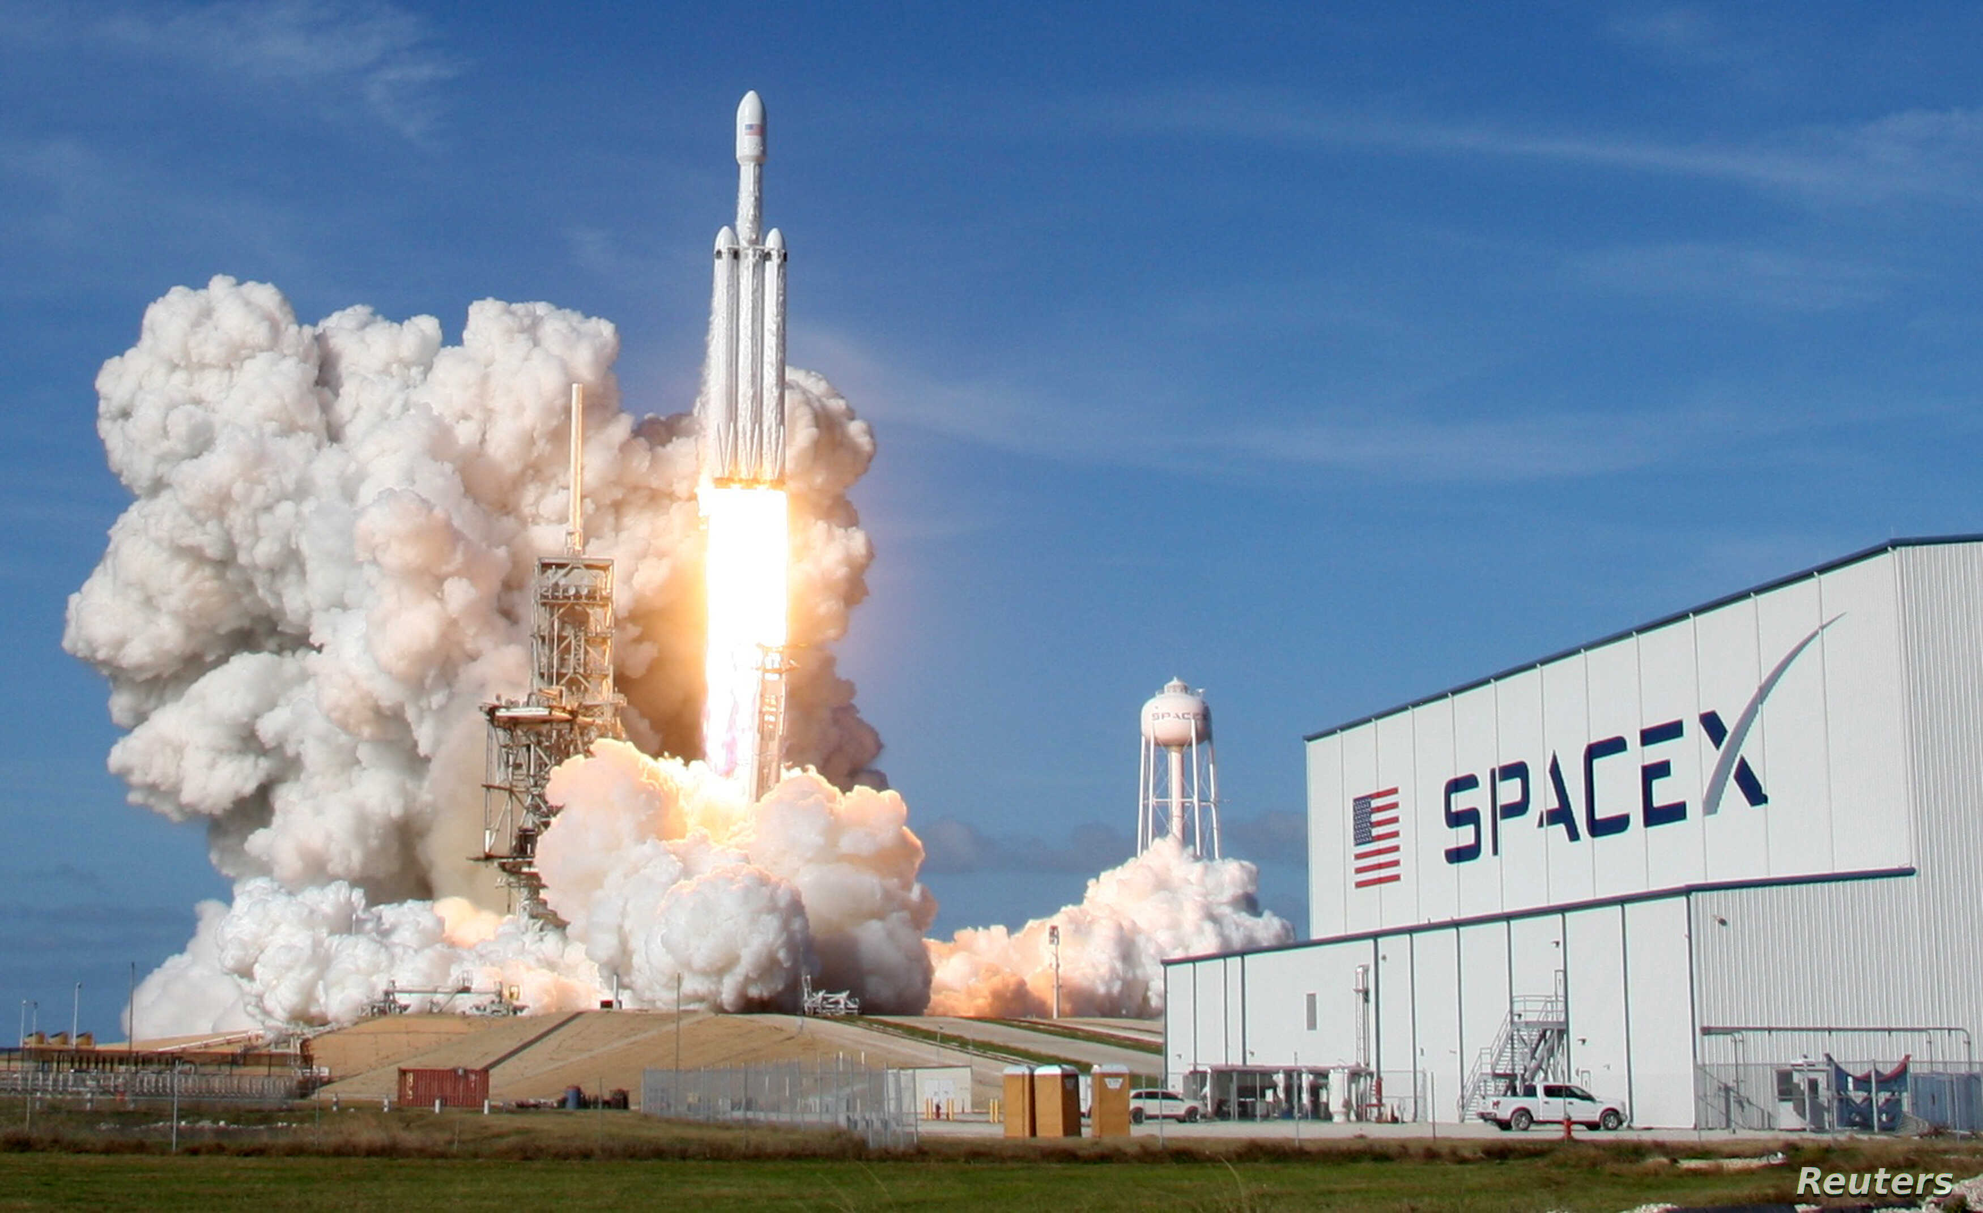

Vector and Scalar Quantities
We will compare vector and scalar quantities
Notes:
Insert cover image and use transparency settings to fade image.

Slide 2
Do not delete this slide.
This slide is designed so that you can copy the prompt box you need and insert it into your slides.
This slide is hidden and will not be included when presenting your lesson.
TRACK WITH ME
VOCABULARY
1 -
HINT
Students, remember….
CHECK FOR UNDERSTANDING
READ WITH ME
TEACHER CUE
MAKE THE CONNECTION
Students, you already know….
EXTENSION
GESTURE WITH ME

Slide 3
Year 10 Physics – Intro Kahoot
Join with your first name included in your username
https://create.kahoot.it/details/year-10-physics/deba5ffc-95c6-4777-8ad5-1c4e672e2a88

Slide 5

WHY STUDY PHYSICS
Physics is crucial to understanding the world around us, the world inside us, and the world beyond us. It is the most basic and fundamental science.
Physics challenges our imaginations with concepts like relativity and string theory, and it leads to great discoveries, like computers and lasers, that lead to technologies which change our lives—from healing joints, to curing cancer, to developing sustainable energy solutions.
Moreover, it’s the basis of many other sciences, including chemistry, oceanography, seismology, and astronomy (and can be applied to biology or medical science).

Slide 6
WHY STUDY PHYSICS
Physicists are problem solvers. Their analytical skills make physicists versatile and adaptable so they work in interesting places.
Physicists brings a broad perspective to any problem. Because they learn how to consider any problem - they are not bound by context. This inventive thinking makes physicists desirable in any field.
Physics is a great foundation for careers in: Journalism; Law; Finance; Medicine; Engineering; Computer Science; Astronomy; Biology

Slide 7

Why Study Physics?
Four fundamental reasons are put forth:
1) The thinking framework for advancement
2) A functioning society requires citizens to understand science
3) Money
4) Pleasure

Slide 8
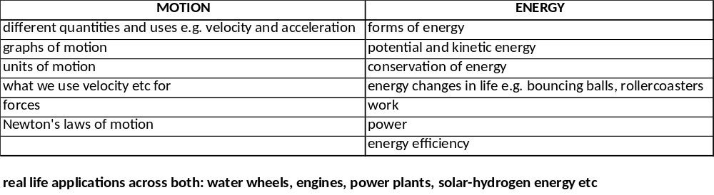
WHAT WE WILL BE STUDYING

Slide 9
We will compare vector and scalar quantities
TRACK WITH ME
READ WITH ME
We will define a scalar and vector quantity
We will define and describe the difference between distance and displacement
We will define and describe the difference between speed and velocity
DECLARE THE OBJECTIVE
Read the learning objective to your partner.
Notes:
Learning Objectives contain concepts (nouns, big ideas), skills (verbs, measurable behaviours) and sometimes context (restricting or targeting conditions).
●Example: Students will be able to describe the concept of density and apply it to floating and sinking.
●
Success criteria are specific measurable outcomes that if met mean that the student has met the learning objective.
Examples:
•Students will be able to compare densities of substances using mass and volume.
•Students will be able to identify whether a solid or liquid will float or sink in a liquid based on their densities.

Slide 10
We will compare vector and scalar quantities
Student example of scalar vs. vector
Walk 10 steps
Walk 10 steps north
Walk for 5 seconds
Walk for 5 seconds south
Do 5 pushups
MAKE THE CONNECTION
Students, you already know….

Slide 11
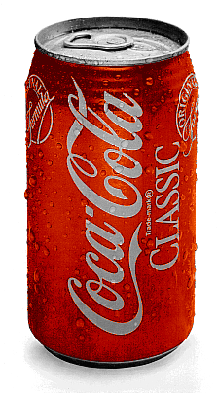
CHECK FOR UNDERSTANDING
What does magnitude mean?
We will compare vector and scalar quantities
A scalar quantity is a quantity that has magnitude only and has no direction in space
Volume is a scalar quantity
Examples of Scalar Quantities:
Length
Area
Volume
Time
Mass
e.g. a can holds 300ml of coke

Slide 12
We will compare vector and scalar quantities
A vector quantity is a quantity that has both magnitude and a direction in space
Examples of Vector Quantities:
Displacement
Velocity
Acceleration
Force
10 N
e.g.
The student uses a force of 10 N downwards to crush the can

Slide 13
We will compare vector and scalar quantities
Explain why the mass of a car is a scalar quantity whilst the velocity it has is a vector quantity
Explain why time cannot be a vector quantity

Slide 14
Scalar or vector?
Quantity | Scalar or vector
Energy
Length
Temperature
Mass
Weight
Area
Speed
Volume
Time
Velocity
Acceleration
Energy | S
Length | S
Temperature | S
Mass | S
Weight | V
Area | S
Speed | S
Volume | S
Time | S
Velocity | V
Acceleration | V
Notes:
S: Distance, power, charge, density

Slide 15

We will compare vector and scalar quantities
DISTANCE vs DISPLACEMENT
Distance: is defined as the total length a body moves between two points – how much ground an object covers during its motion.
Distance is a SCALAR quantity “d”
Distance has magnitude only
Displacement: is defined as the straight line distance between two points – the objects overall change in position
Displacement is a VECTOR quantity “s”
Displacement has magnitude AND direction

Slide 16
Here we have a man walking 10km north and then 10km walking east. Notice that we can replace his two movements with a “displacement vector”. Note the length and direction of this vector.
10km
He has been displaced 14.1km North East
10km
14.1km

Slide 17


Slide 18
Distance is a scalar quantity that refers to how much ground an object has covered during its motion
Displacement is a vector quantity that refers to how far out of place an object is; it is the objects overall change in position
Lieutenant Dan walks 4 meters East, 2 meters South, 4 meters West and finally, 2 meters North.
4m
What is the distance covered?
What is the displacement?
2m
2m
4m

Slide 19
A tricky example
Lieutenant Dan walks round a park, first walking north for 80m, then turning right and walking for 50m.
He then turns right again, and after 10m takes a left turn and continues for 70m. How far has he travelled from his start point.

Slide 20
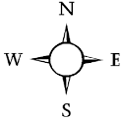
50m
10m
70m
80m

Slide 21
50m
10m
70m
80m

Slide 22
50m
10m
70m
80m
120m

Slide 23
50m
10m
70m
80m
120m

Slide 24
50m
10m
70m
80m
70m
120m

Slide 25
50m
10m
70m
80m
70m
120m

Slide 26
50m
10m
70m
80m
120² + 70² = x²
70m
120m

Slide 27
50m
10m
70m
80m
139m
70m
120m

Slide 28
50m
10m
70m
80m
139m
NE
70m
120m

Slide 29
SPEED VS VELOCITY
Speed is a measure of how quickly an object is travelling.
It is a scalar quantity.
→ It is the rate of change of distance with respect to time.
Velocity is a measure of how quickly an object is travelling and its direction. It is a vector quantity.
→ It is the rate of change of displacement with respect to time.

Slide 30
SPEED VS VELOCITY
Speed | Velocity
Both are a measure of the rate of motion. (rate means an amount per unit of time)
Both use units such as km/h and m/s (kilometres per hour & metres per second)
Is a scalar quantity based upon distance. | Is a vector quantity based upon displacement.

Slide 31
We will compare vector and scalar quantities
https://play.kahoot.it/v2/?quizId=5db6d9e4-acc7-42dd-aee2-750bbec907a4

Slide 32
Enter Learning Objective
Task
Task
CHECK FOR UNDERSTANDING
HINT
Students, remember….
VOCABULARY

Slide 33
Enter Learning Objective
CHECK FOR UNDERSTANDING
VOCABULARY

Slide 34
Enter Learning Objective
Task
Task
CHECK FOR UNDERSTANDING
HINT
Students, remember….
VOCABULARY
Notes:
Please include tasks/questions here rather than just referring to a worksheet. This will save on photocopying and facilitate sharing with other schools.
Try and build tasks/questions which escalate through Bloom’s Taxonomy. This will help with differentiation.

Slide 35
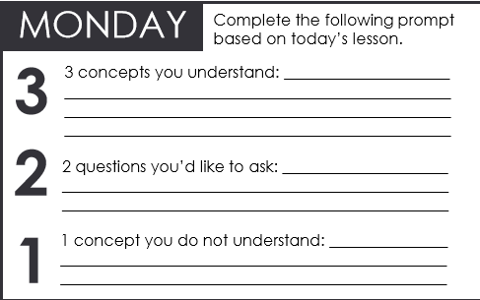
We will compare vector and scalar quantities
We will define a scalar and vector quantity
We will define and describe the difference between distance and displacement
We will define and describe the difference between speed and velocity
CHECK FOR UNDERSTANDING
Check Success Criteria.
Notes:
Learning Objectives contain concepts (nouns, big ideas), skills (verbs, measurable behaviours) and sometimes context (restricting or targeting conditions).
●Example: Students will be able to describe the concept of density and apply it to floating and sinking.
●
Success criteria are specific measurable outcomes that if met mean that the student has met the learning objective.
Examples:
•Students will be able to compare densities of substances using mass and volume.
•Students will be able to identify whether a solid or liquid will float or sink in a liquid based on their densities.

